Slide 1


CS-3002: Information Security
Lecture # 1: Security Goals, History of Attack and Underground Economy
Prof. Dr. Sufian Hameed
Department of Computer Science
FAST-NUCES

Slide 2
What is This Class About ?
Learn About Security
Make a Difference

Slide 3
How Can You Make a Difference?
Be a more security-- aware user
Make better security decisions
Be a more security– aware developer
Design & build more secure systems
Be a security practitioner & researcher
Identify security issues
Propose new security solutions

Slide 4
Computer Security Today

Slide 5
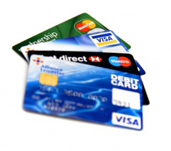

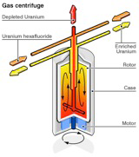
Why Computer Security ?
Computer systems are ubiquitous in our daily life
Computers store and process our data and information
Computers access and control our resources
Valuable Data
Private Data
Dangerous Data

Slide 6
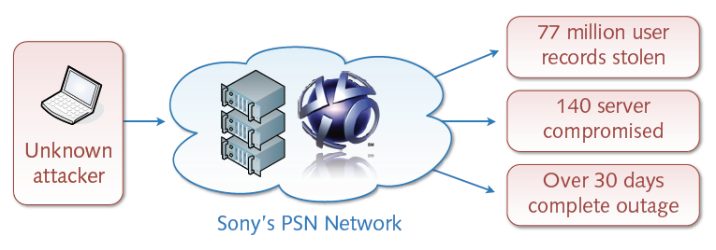
The Sony Breach
An Example: The Playstation Network (PSN) Attack
Illegal intrusion into network around April 2011
Severe consequences for users and companies
Financial damage of over 24 billion dollars

Slide 7
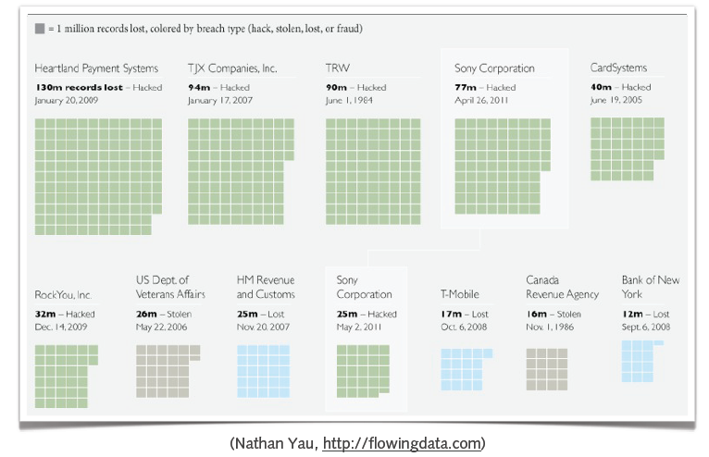
Top Data Breaches

Slide 8
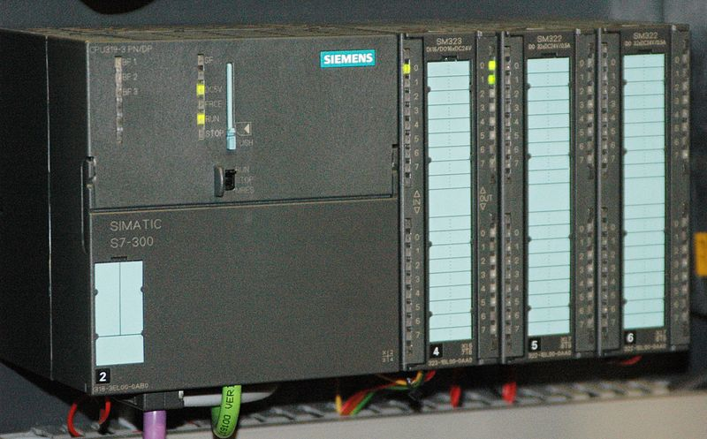
Further Example
Stuxnet Worm
Computer worm detected in January 2010
Initially spread via MS Windows and targets Siemens industrial software and equipment (SCADA)
Spies on and disrupts industrial systems
Possible sabotage against uranium enrichment infrastructure in Iran
Rustock Botnet
Network of 1.7 million infected systems (zombies)
Capability of sending 22 million spam messages per day
Active from around 2007 to March 2011
Taken down by Microsoft, U.S. Fed Agents and University of Washington
On July 18, 2011, Microsoft put a bounty of US$ 250 K on the individual behind Rustock botnet.
Notes:
Stuxnet
Stuxnet is a highly sophisticated computer worm. Discovered in June 2010, Stuxnet initially spreads via Microsoft Windows, and targets Siemens industrial software and equipment. While it is not the first time that hackers have targeted industrial systems, it is the first discovered malware that spies on and subverts industrial systems, and the first to include a programmable logic controller (PLC)rootkit.
The worm initially spreads indiscriminately, but includes a highly specialized malware payload that is designed to target only Siemens supervisory control and data acquisition (SCADA) systems that are configured to control and monitor specific industrial processes. Stuxnet infects PLCs by subverting the Step-7 software application that is used to reprogram these devices.
Different variants of Stuxnet targeted five Iranian organizations, with the probable target widely suspected to be uranium enrichment infrastructure in Iran
Rustock
On March 16, 2011, the botnet was taken down through what was initially reported as a coordinated effort by Internet service providers and software vendors. It was revealed the next day that the take-down, called Operation b107, was the action of Microsoft, U.S. federal law enforcement agents, FireEye, and the University of Washington.
To capture the individuals involved with the Rustock botnet, on July 18, 2011, Microsoft is offering "a monetary reward in the amount of US$250,000 for new information that results in the identification, arrest and criminal conviction of such individual(s)."

Slide 9
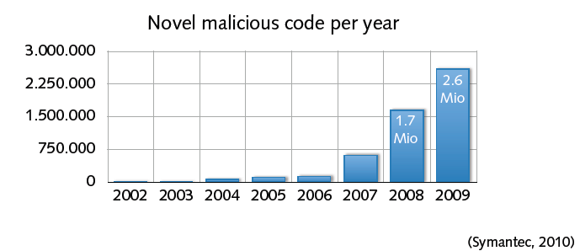
… more trouble ahead
Cyberspace — a dangerous place
Omnipresence of computer attacks, viruses and worms
Persistent underground economy (worth billions of dollars)
Soon cyber-terrorism and cyber-warfare?
Notes:
OmniPresence … ?

Slide 10
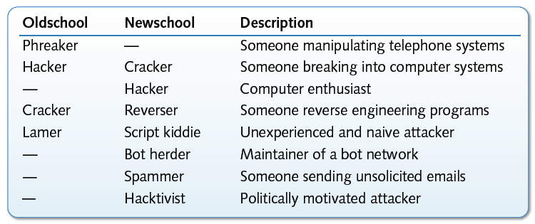
Who is who ?
Informal terminology of attackers
Various other types of attackers, e.g. crime, military, agencies, ...

Slide 11
Security is fun too!
Security is different from other disciplines
Established concepts are put into questions
Intersection with many areas of computer science
Often, it’s a game of good and evil players
Practice and theory of security are often fun
Monitoring, detection and analysis of real attacks
Reasoning about limits of attacks and defenses

Slide 12
Security Goals and Mechanisms

Slide 13
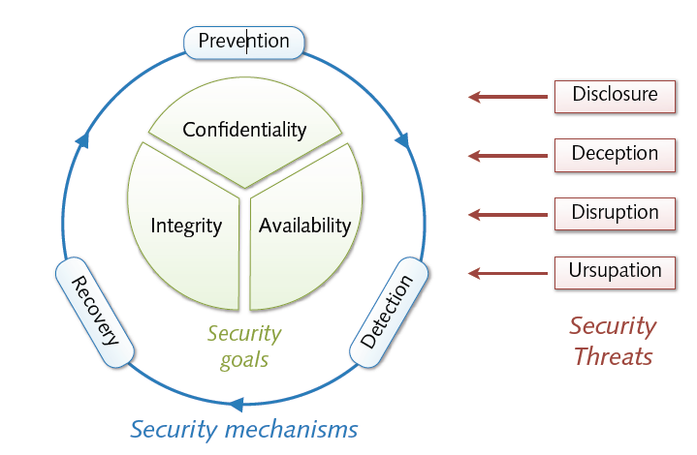
A Formal View

Slide 14
Security Goals
Security goals (memory hook: “CIA”)
Confidentiality of information and resources
Integrity of information and resources
Availability of information and resources
Basic definitions
Threat = potential violation of a protective goal
Security = protection from intentional threats
Safety = protection from accidental threats

Slide 15

Confidentiality
Confidentiality
Protection of resources from unauthorized disclosure
Check: Who is authorized to access which resources?
Security measures
Encryption of data, resource hiding
Examples
An attacker eavesdrop a telephone conversation
An attacker reads the emails on your computer

Slide 16
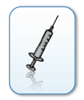
Integrity
Integrity
Protection of resources from unauthorized manipulation
Check: Who does what on which resources?
Security measures
Authorization, checksums, digital fingerprints
Examples
An attacker changes the receipt of a bank transaction
An attacker tampers with files on your computer

Slide 17

Availability
Availability
Protection of resources from unauthorized disruption
Check: When and how are which resources used?
Security Measures
Restriction, redundancy, load balancing
Examples
An attacker crashes the web server of a company
An attacker formats the hard disk of your computer

Slide 18
Threats & Attacks
Basic classes of threats
Disclosure = unauthorized access to information
Deception = acceptance of false data (e.g. masquerading)
Disruption = interruption or prevention of correct operation
Usurpation = unauthorized control of resources
Attack = attempt to violate a security goal (intentional threat)
Often combinations of different threat classes

Slide 19
Examples of Attacks
Snooping = passive eavesdropping of information
→ disclosure
✸ network sniffing, keyboard logging
Manipulation = active modification of information
→ deception, disruption and usurpation
✸ redirection of control flow, man-in-the-middle attacks
Spoofing = impersonation of one entity by another
→ deception and usurpation
✸ address spoofing, phishing attacks
Notes:
usurpation

Slide 20
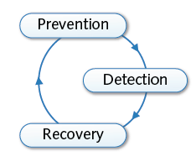
Security Mechanisms
Security policies and mechanisms
Policy = statement of what is and what is not allowed
Mechanism = method or tool enforcing a security policy
Strategies for security mechanisms
Prevention of attacks
Detection of attacks
Recovery from attacks
Bruce Schneier: Security is a process, not a product!

Slide 21
Prevention
Prevention of attacks
Prevention of attacks prior to violation of security goals
Examples
Data reduction and separation
Removal or separation of information and resources
Authentication and encryption
Restriction of access to information and resources
Limitations
Inapplicable in many settings, e.g. open services

Slide 22
Detection
Detection of attacks
Detection of attacks during violation of security goals
Examples
Anti-virus scanners
Detection of malicious code on computers
Network intrusion detection
Detection of attacks in computer networks
Limitations
Ineffective against unknown and “invisible” attacks

Slide 23
Recovery
Recovery
Recovery from attacks after violation of security goals
Examples
Computer forensics
Investigation and analysis of security incidents
Malware analysis
Observation and analysis of malicious software
Limitations
Severe damage might have already occurred

Slide 24
Further Concepts
Authenticity = truthfulness of information and resources
May be viewed as an aspect of integrity
Accountability = linking of actions and users
Realization of non-repudiation in computer systems
Privacy = Security and control of personal information
Property of individuals and not of data
Notes:
Non-repudiation : purported maker of a statement will not be able to successfully challenge the validity of the statement

Slide 25
History of Attacks

Slide 26
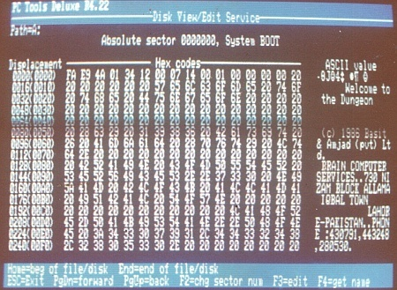
Brain: Where it all started …..
Brain released in January 1986, is considered to be the first computer virus for MS-DOS.
Infects the boot sector of storage media formatted with the DOS File Allocation Table (FAT) file system.
Written by two brothers, Basit Farooq Alvi and Amjad Farooq Alvi from lahore.

Slide 27
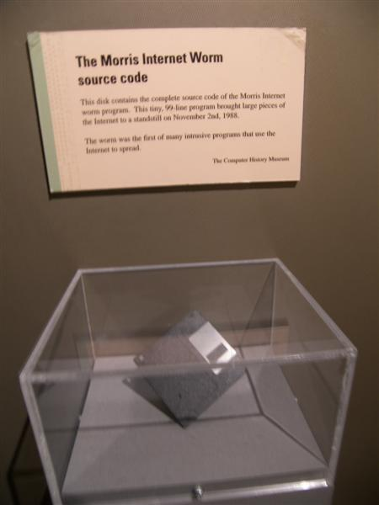
Morris
The Morris worm (November 2, 1988) was one of the first computer worms distributed via the Internet.
It was written by a student at Cornell University, Robert Tappan Morris.
The small program disables roughly 6,000 computers (10% of the internet) by flooding their memory banks with copies of itself.
He is fined $10,000 and sentenced to three years' probation.
Notes:
Worms are Standalone malware. Unlike a computer virus, it does not need to attach itself to an existing program.

Slide 28
Melissa
Melissa virus, created by David L Smith, was reported in 1999
Exploited MS-Word, Outlook
The virus was attached along with emails which had a message: “Here is that document you asked for, don’t show it to anybody else”
On activation, it sends the same to the top 50 people in the contacts list
Caused a heavy damage due to heavy traffic and it lead to the shutting down of email gateways of companies like Intel Corp., Alcatel Lucent, Microsoft .etc

Slide 29
ILoveLetter worm
The "I Love You" virus (5 may 2000) infects millions of Windows PC overnight
Started spreading as an email message with the subject line "ILOVEYOU" and the attachment "LOVE-LETTER-FOR-YOU.txt.vbs“
Opening the attachment activated the Visual Basic script
The worm did damage on the local machine, overwriting image files, and sent a copy of itself to the first 50 addresses in the Windows Address Book used by Microsoft Outlook.
Also sends passwords and usernames stored on infected computers back to the virus's author.
Authorities trace the virus to a young Filipino computer student, but he goes free because the Philippines has no laws against hacking and spreading computer viruses.

Slide 30
CodeRed
The Code Red worm, released on 13th July, 2001, attacked Microsoft’s IIS web servers
Sneaked through the server via a patch in the indexing software with IIS
Used the buffer overflow technique (a long string of repeated character ‘N’ was used to overflow a buffer)
A fix was found in a month’s time which limited the damage to $2.5 billion.
The affected sites were defaced with the message
HELLO! Welcome to http://www.worm.com! Hacked By Chinese!

Slide 31
Nimda
Nimda was a file infector worm released on September 18, 2001,
Spread through out the world in 22 minutes
It used different methods for propagation i.e. emails, open network shares, backdoor left by other viruses
Nimda spelled backwards is “Admin”
Damage caused by Nimda : $ 635 million!

Slide 32
SQL Slammer aka Sapphire worm
SQL Slammer or the worm that ate the internet (January 25, 2003) caused a denial of service on some Internet hosts and dramatically slowed down general Internet traffic
Exploits the vulnerability in the Microsoft SQL servers and uses the buffer overflow bug to slow down the servers
Slows down the entire Internet.
Infects hundreds of thousands of computers in less than three hours
The fastest-spreading worm ever knocking cash machines offline and delaying airline flights

Slide 33
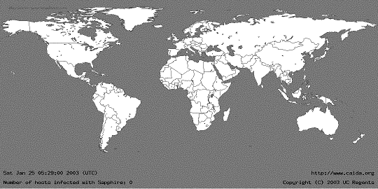
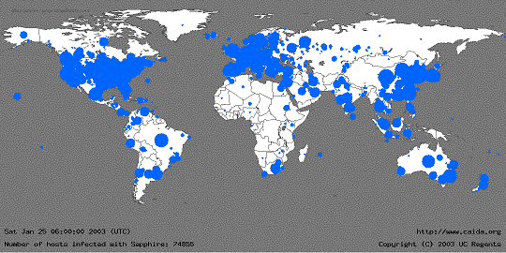
SQL Slammer

Slide 34
Current Trends

Slide 35
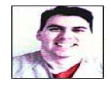
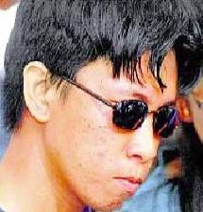
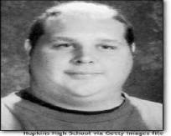
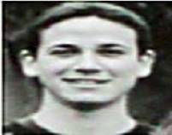
Historical hackers (prior to 2000)
Profile:
Male
Between 14 and 34 years of age
Computer addicted
No social life
No Commercial Interest !!!
Source: Raimund Genes

Slide 36
Historical Hackers
1990s:
Phone phreaking, Free calls
Early 2000s:
Email worms
CodeRed, Nimda

Slide 37
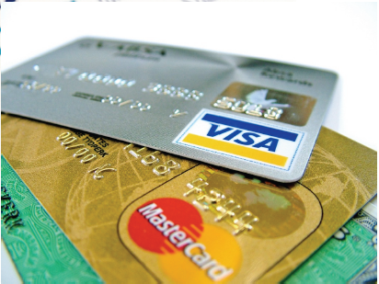
Financially Motivated
Shift in late 2000s
Spam
Pharmaceuticals
Fake products
Carding/Fraud
Identify theft, credit fraud

Slide 38
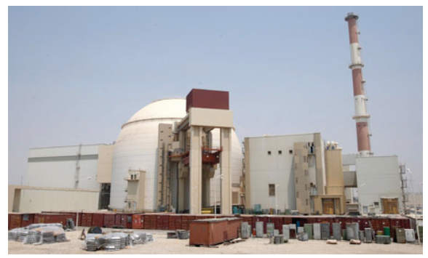
Politically Motivated
Stuxnet

Slide 39
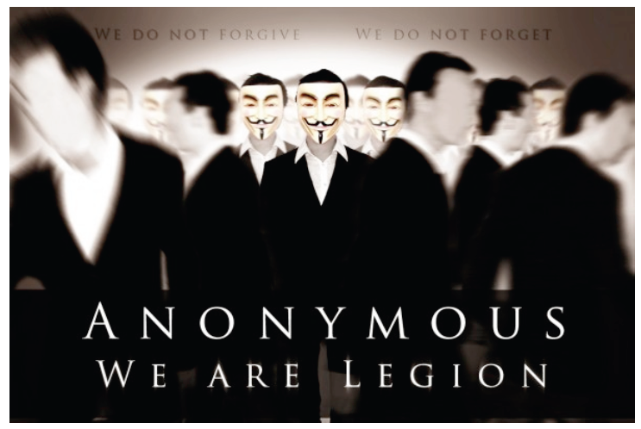
Politically Motivated

Slide 40
Typical Botherder: 0x80" (pronounced X-eighty)
High school dropout
“…most of these people infect are so stupid they really ain't got no business being on the Internet in the first place.“
Working hours: approx. 2 minutes/day to manage Botnet
Monthly earnings: $6,800 on average
Daily Activities:
Chatting with people while his bots make him money
Recently paid $800 for an hour alone in a VIP room ….
Job Description:
Controls 13,000+ computers in more than 20 countries
Infected Bot PCs download Adware then search for new victim PCs
Adware displays ads and mines data on victim's online browsing habits.
Bots collect password, e-mail address, SS#, credit and banking data
Washington Post: Invasion of the Computer Snatchers

Slide 41
Some things in the news
Nigerian letter (419 Scams) still works:
Michigan Treasurer Sends 1.2MUSD of State Funds !!!
Many zero-day attacks
Google, Excel, Word, Powerpoint, Office …
Criminal access to important devices
Numerous lost, stolen laptops, storage media, containing customer information
Second-hand computers (hard drives) pose risk
Vint Cerf estimates ¼ of PCs on Internet are bots

Slide 42
Trends since 2010
Texas CISO, Feb 2010
Malware, worms, and Trojan horses
spread by email, instant messaging, malicious or infected websites
Botnets and zombies
improving their encryption capabilities, more difficult to detect
Scareware – fake/rogue security software
Attacks on client-side software
browsers, media players, PDF readers, etc.
Ransom attacks
malware encrypts hard drives, or DDOS attack
Social network attacks
Users’ trust in online friends makes these networks a prime target.
Cloud Computing - growing use will make this a prime target for attack.
Web Applications - developed with inadequate security controls
Budget cuts - problem for security personnel and a boom to cyber criminals.
Same list in Oklahoma Monthly Security Tips Newsletter

Slide 43
Monetization of Exploits

Slide 44
Marketplace for Vulnerabilities
Option 1: Bug Bounty Programs
Google vulnerability reward program: 3K $
Mozilla big bounty program: 500 $
Pwn2Own competition: 15K $
Option 2:
ZDI, iDefense purchases: 2K-10K $
Zero Day Initiative | 3Com | TippingPoint, a division of 3Com, http://www.zerodayinitiative.com/
Vulnerability Contributor Program // iDefense Labs, http://labs.idefense.com/vcp/

Slide 45
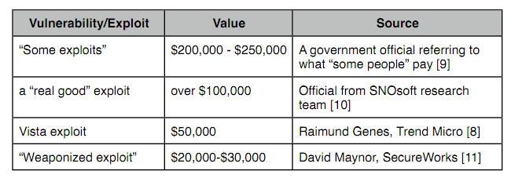
Marketplace for Vulnerabilities
Option 3: Black Market
Source: Charlie Miller (http://securityevaluators.com/files/papers/0daymarket.pdf). This is a very good read, also discussed the challenges involving legitimate buyers.

Slide 46
Underground Economy
Spam service
Rent-a-bot
Cash-out

Slide 47
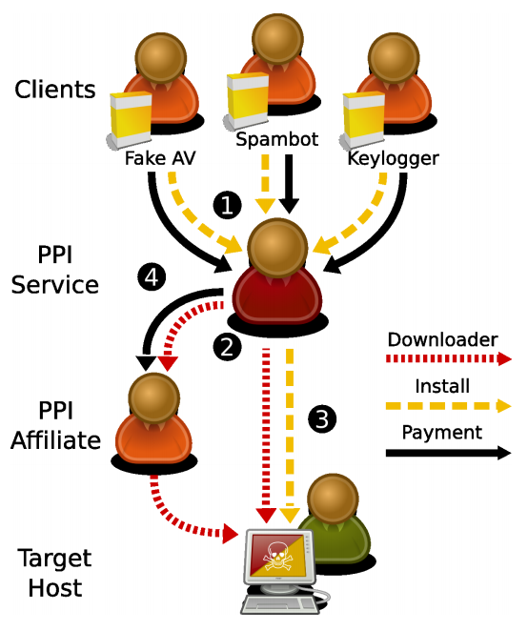
Marketplace for Pay-Per-Install (PPI)
Credit: Zulfikar Ramzan

Slide 48
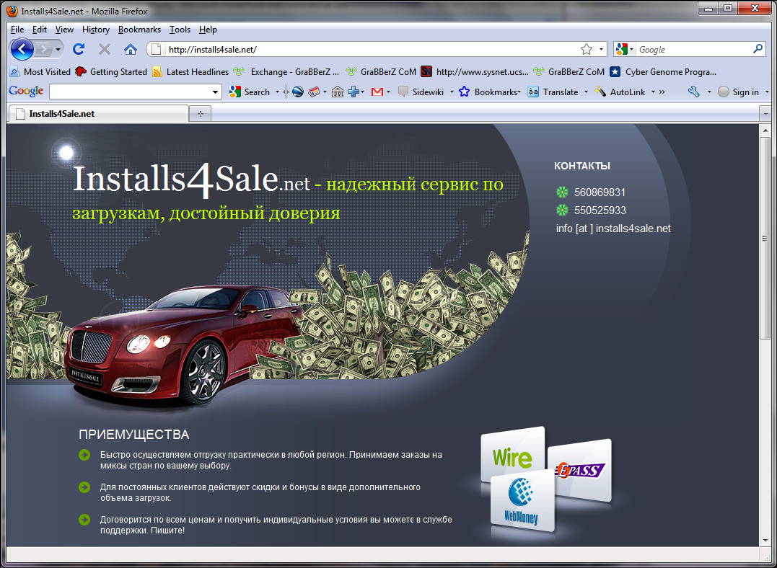

Slide 49
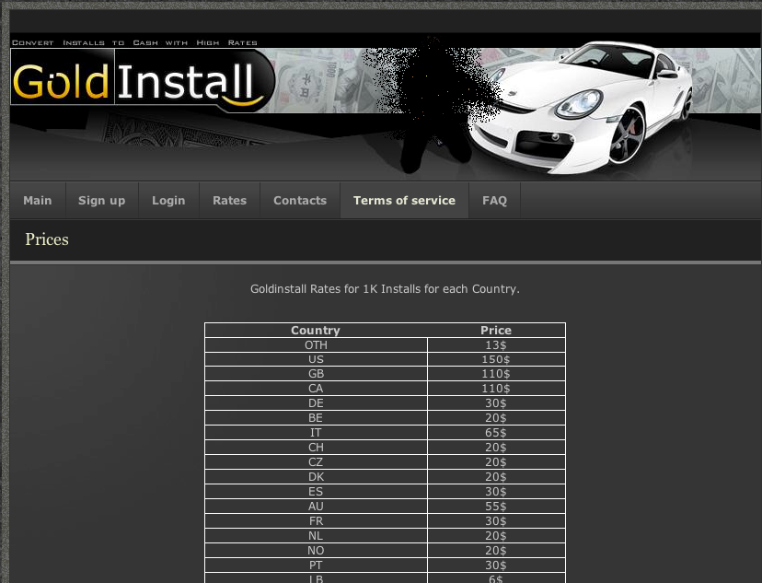

Slide 50
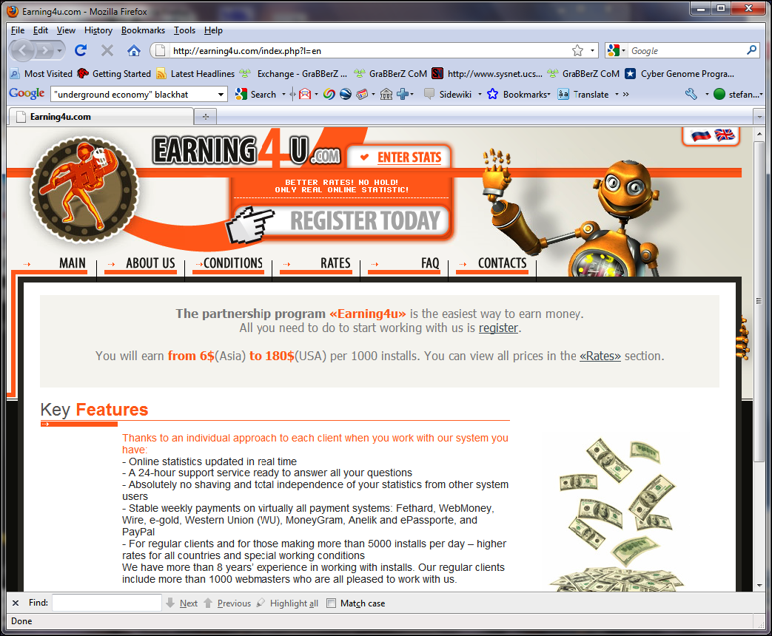

Slide 51
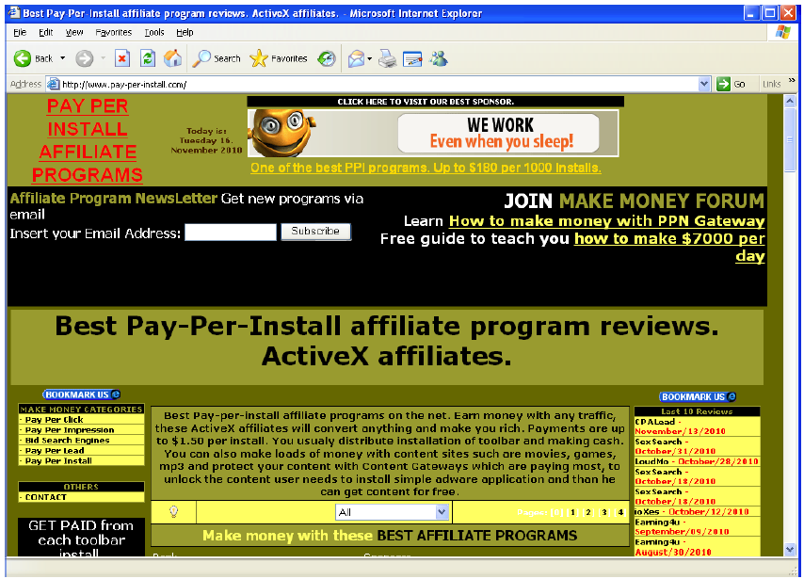

Slide 52
Recommended reading
The Underground Economy of the Pay-Per-Install (PPI) Business by Kevin Stevens
Measuring Pay-per-Install: The Commoditization of Malware Distribution by Juan Caballero (Usenix Sec 2011)

Slide 53
Why are there security vulnerabilities?
Lots of buggy software...
Why do programmers write insecure code?
Awareness is the main issue
Some contributing factors
Few courses in computer security
Programming text books do not emphasize security
Few security audits
C is an unsafe language
Programmers have many other things to worry about
Legacy software (some solutions, e.g. Sandboxing)
Consumers do not care about security
Security is expensive and takes time

Slide 54
If you remember only one thing from this course:
A vulnerability that is “too complicated for anyone to ever find” will be found !
I hope you remember more than one thing

Slide 55
Summary

Slide 56
Summary
Threat landscape is highly dynamic as it is driven by economic motivation, and especially organized crime
No “final state of security”
Prevention not always possible; intelligent response mechanisms are strongly needed.

Slide 57
Acknowledgements
Material in this lecture are taken from the slides prepared by:
Prof. Dr. Konrad Rieck (Uni-Göttingen)

